Slide 1
Gila River Navigability
Presentation to ANSAC
Bob Mussetter, Ph.D., P.E.

Slide 2
Definition of Navigability
A.R.S. § 37‐1101(5)
“Navigable” or “navigable watercourse” means a watercourse that was in existence on February 14, 1912, and at that time was used or was susceptible to being used, in it ordinary and natural condition, as a highway for commerce, over which trade and travel were or could have been conducted in customary modes of trade and travel on water.

Slide 3
Definition of Navigability
PPL Montana
  …evidence [of present-day, primarily recreational use] must be confined to that which shows the river could sustain the kinds of commercial use that, as a realistic matter, might have occurred at the time of statehood.

Slide 4
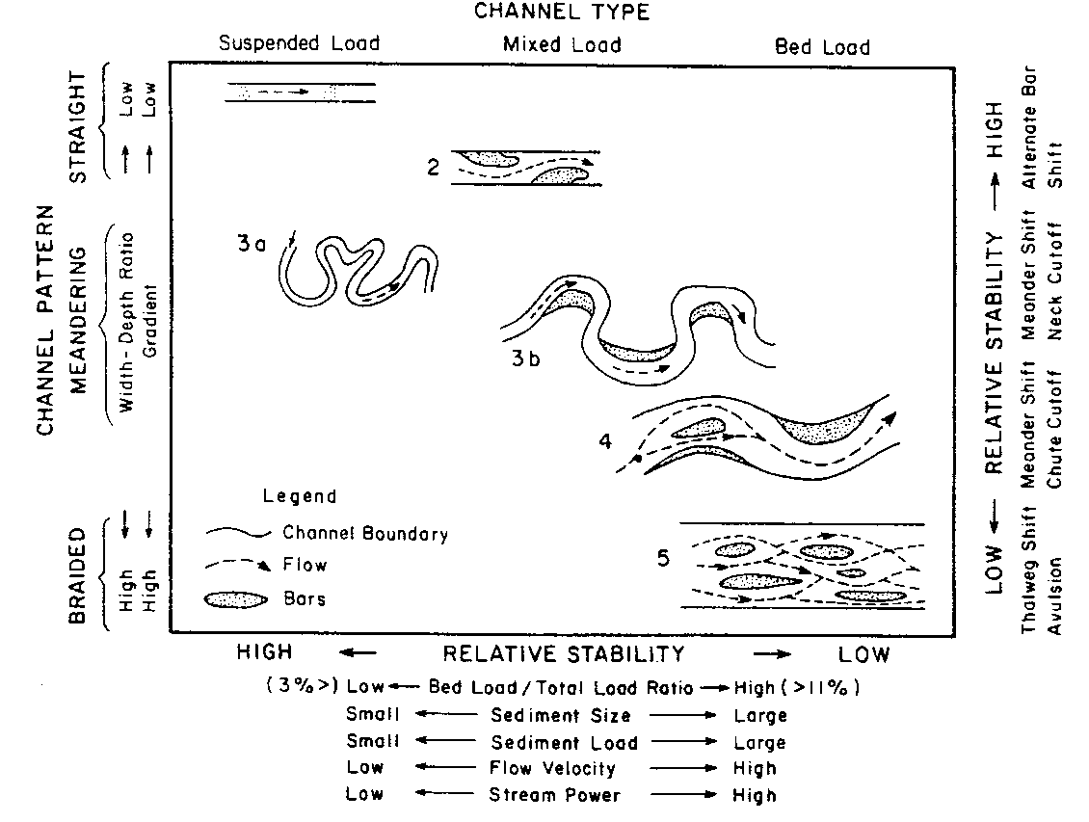
Channel Classification Relevant to Gila River Navigability
Source: Schumm (1981)

Slide 5
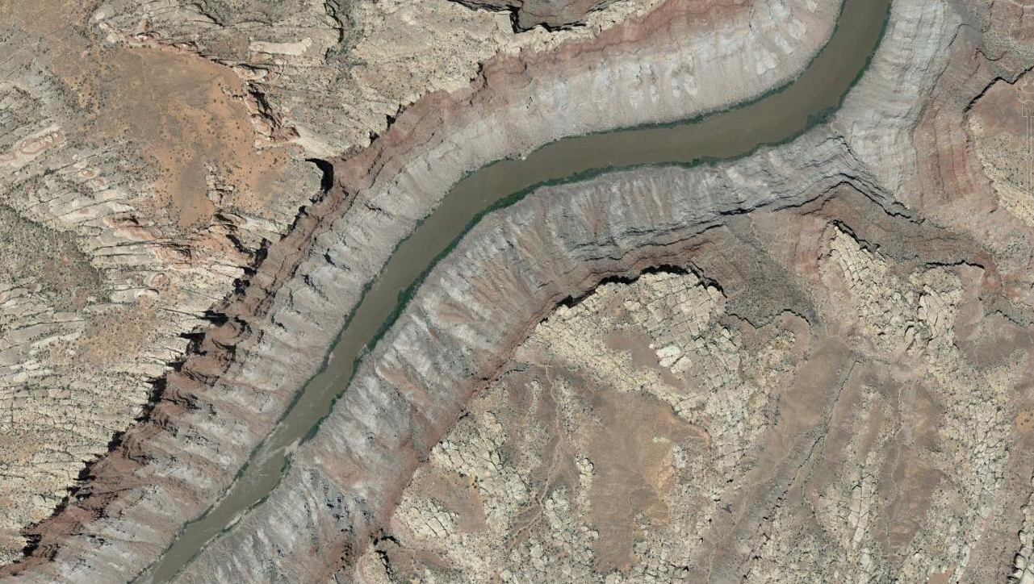
Examples of Channel Types
Single-thread “Navigable” Channel
U.S. v Utah

Slide 6
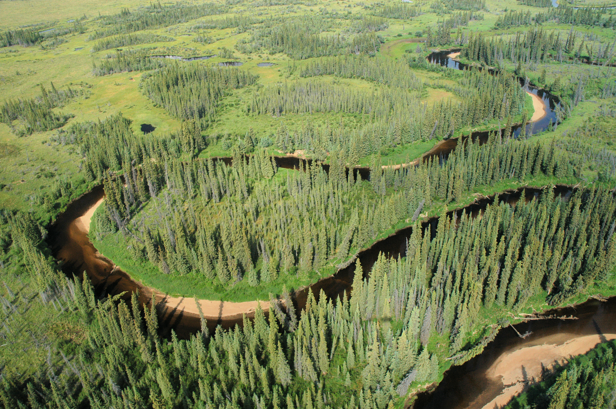
Examples of Channel Types
Single-thread Meandering Channel

Slide 7
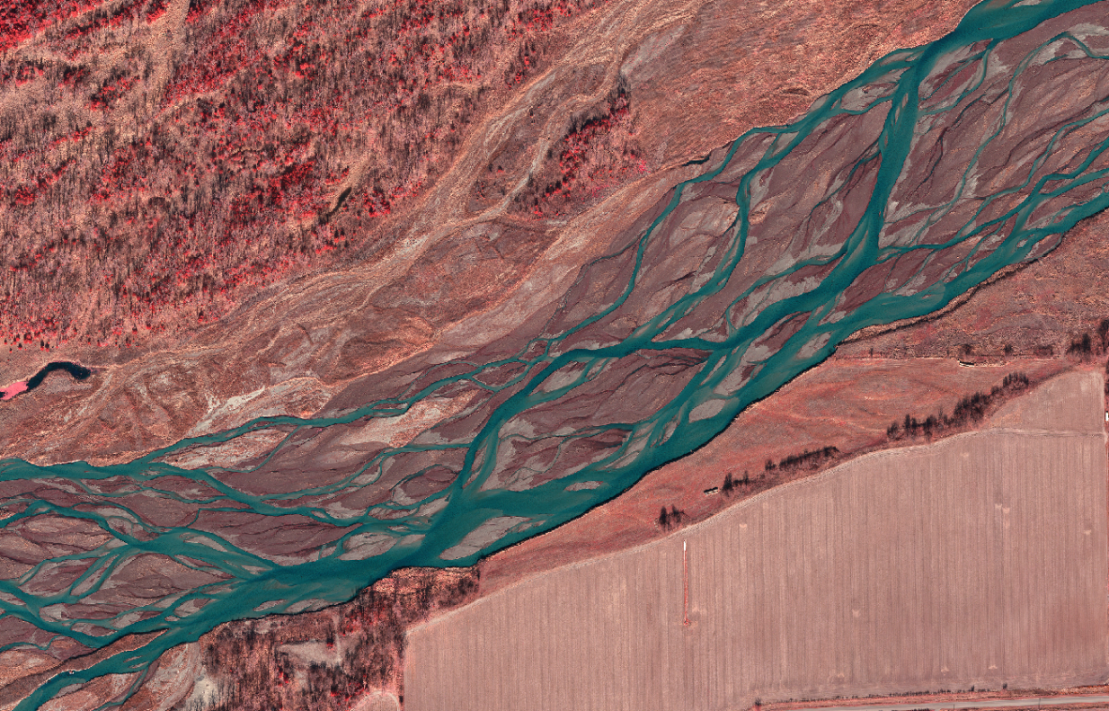
Examples of Channel Types
Braided Sand-bed Channel
Vertical Exaggeration: 40V:1H

Slide 8
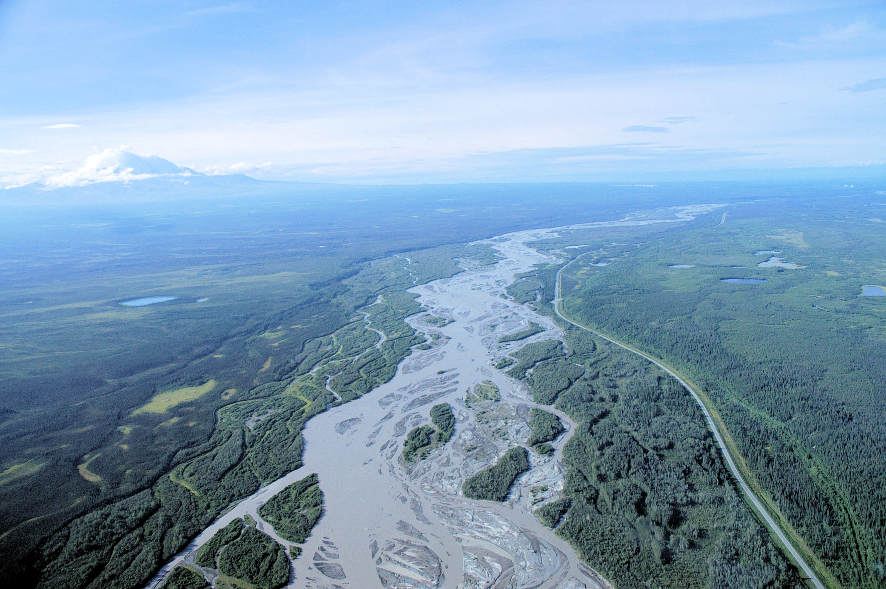
Examples of Channel Types
Braided Cobble-bed Channel
Vertical Exaggeration: 40V:1H

Slide 9
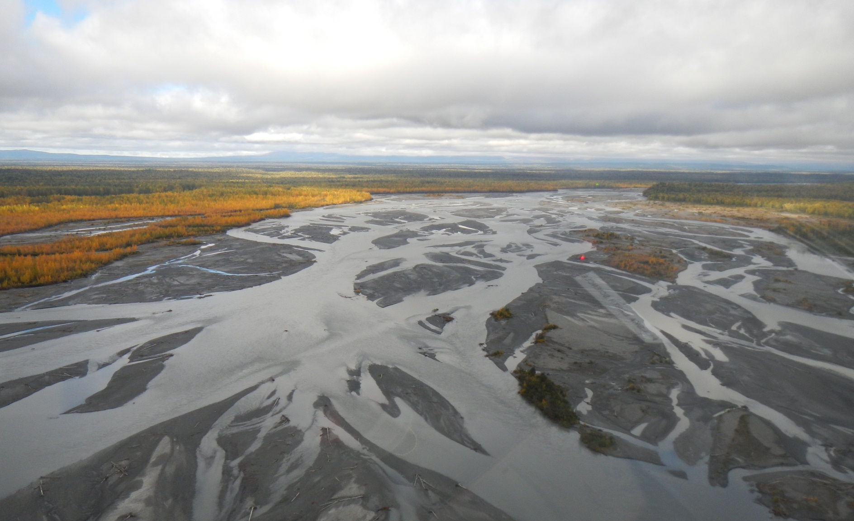
Examples of Channel Types
Braided Cobble-bed Channel

Slide 10
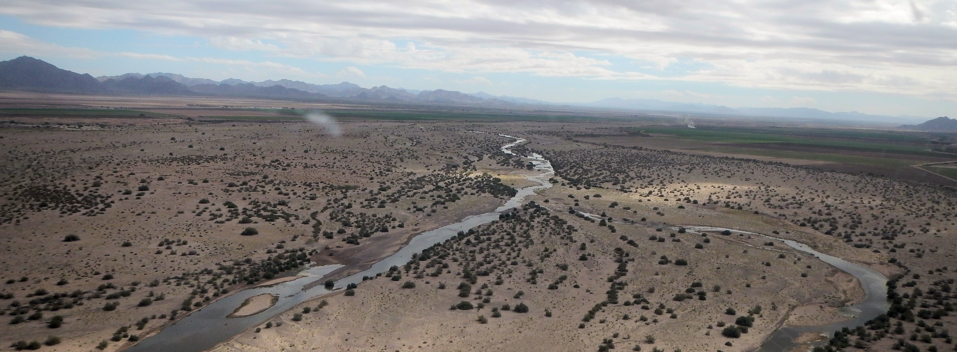
Channel Pattern IS Relevant to Navigability
Braided channels:
  Wide, shallow cross section
  Multiple, unstable (i.e., shifting) channels
  NOT conducive to boating
Typical Braided Reach of Gila River
~3.5 mi Below Gillespie Dam

Slide 11
Channel Pattern IS Relevant to Navigability
United States v Utah (283 U.S. 85)
The principal impediment to navigation is (sic)
found is shifting sandbars….

Slide 12
Gila River Dynamics
Mid-1800s:
  Gila River may have been single-thread channel during periods of extended low flow; however…
Strongly flood driven:
  Periods of increased flood frequency are more likely to be associated with wide, braided channel conditions on the Gila River (Burkham, 1972; Huckleberry, 1993b). Huckleberry (1996), p 4
  The channel changed its geometry when the sustained flow of the floods of January, 1993 converted the compound channel above Pima Butte into a single, wide, braided channel. Huckleberry (1996), p 8

Slide 13
Gila River at Kelvin Flows

Slide 15
Annual Flood Peaks:
Snowmelt and Monsoon

Slide 16
Similar Variability in Annual Volume Pre- and Post-statehood

Slide 17
Annual peak is correlated with annual volume
High-volume years indicates high peak flows

Slide 18
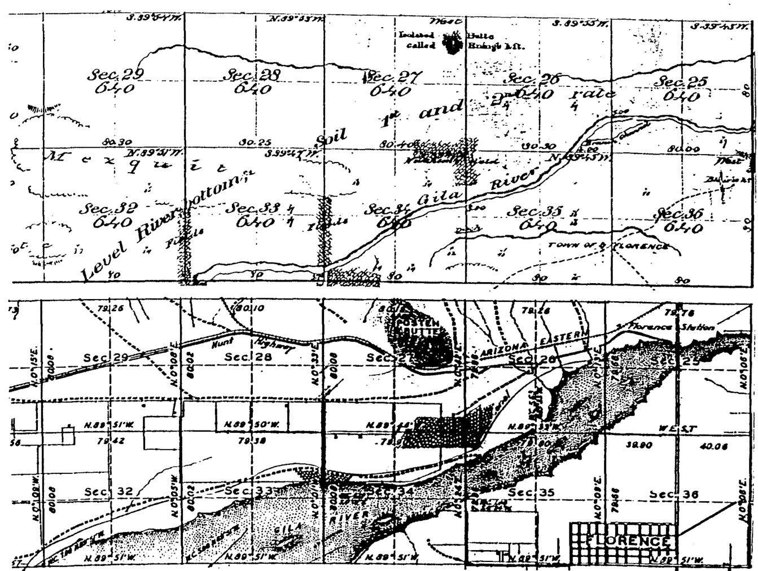
Flood-induced Changes in Channel Width
Figure D from Huckleberry, 1996).
1869
GLO Plats T4S, R9E
1928

Slide 19
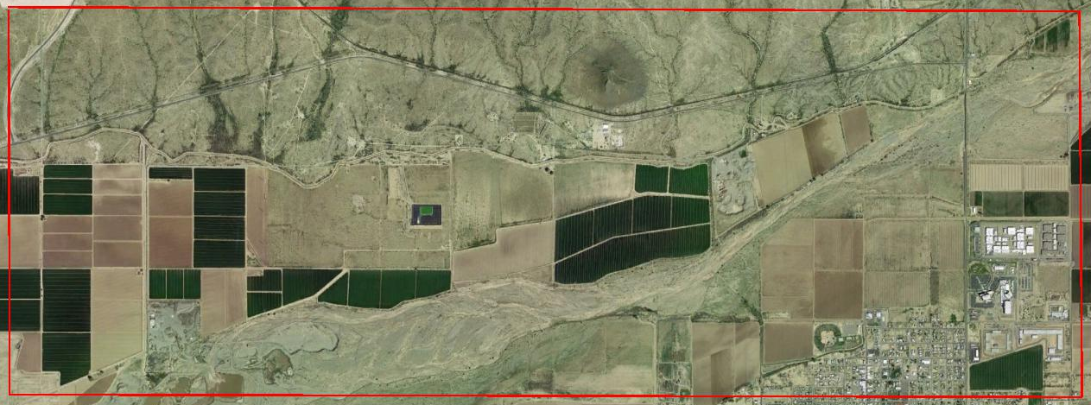
Location of GLO Plat (April 24, 2013)

Slide 20
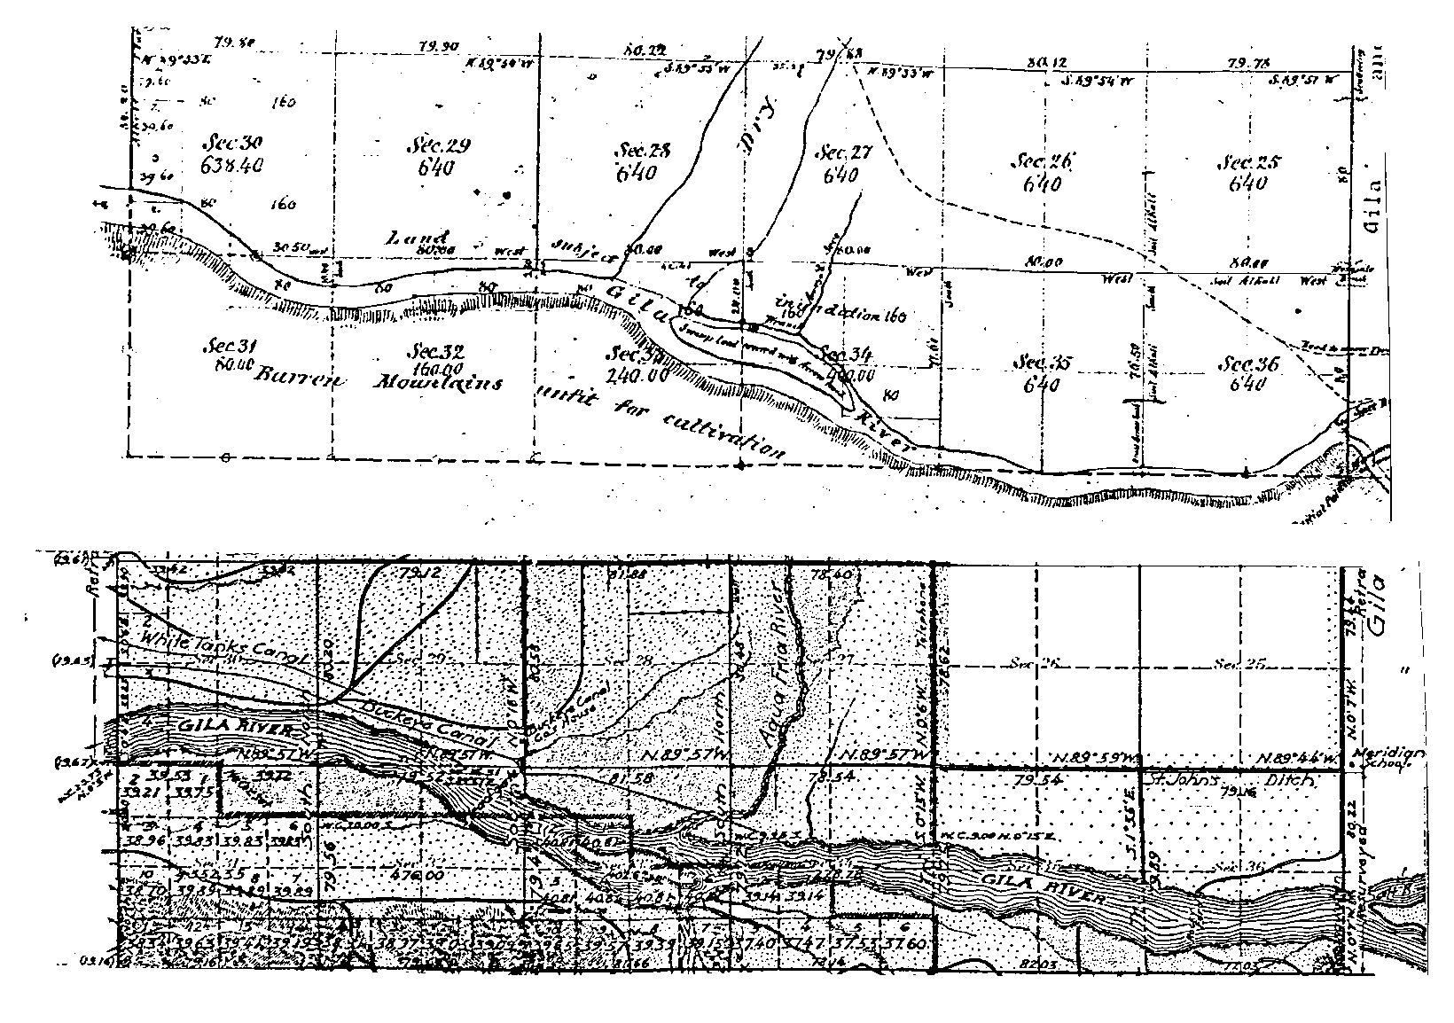
Flood-induced Changes in Channel Width
1867
GLO Plats T1N, R1W
1915

Slide 21
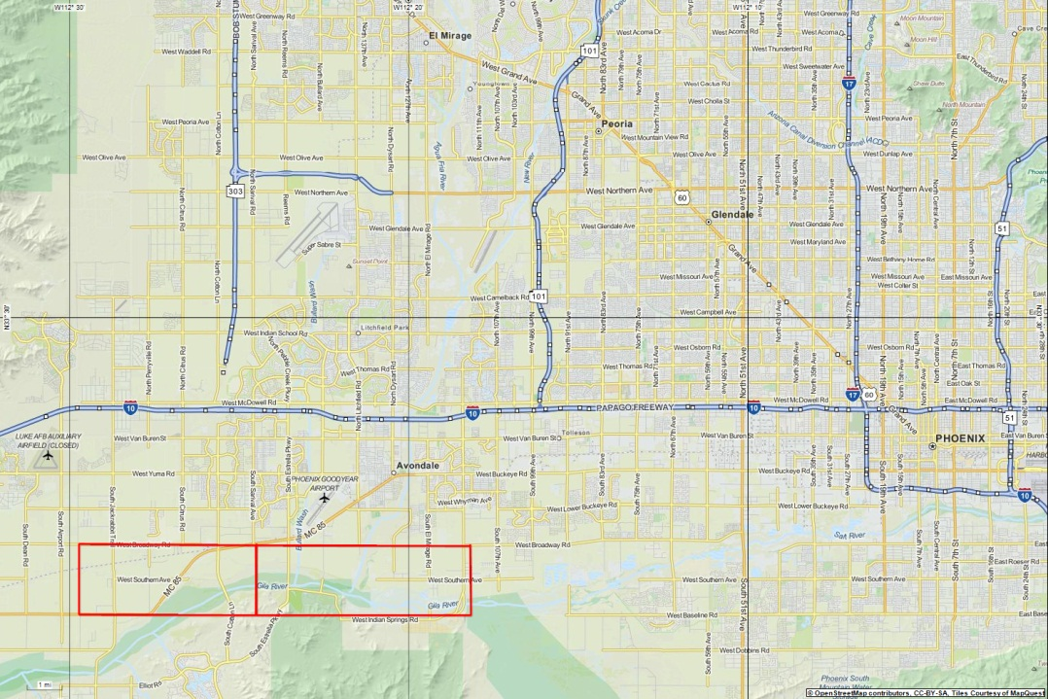
Location of GLO Plat (March 7, 2014)

Slide 22
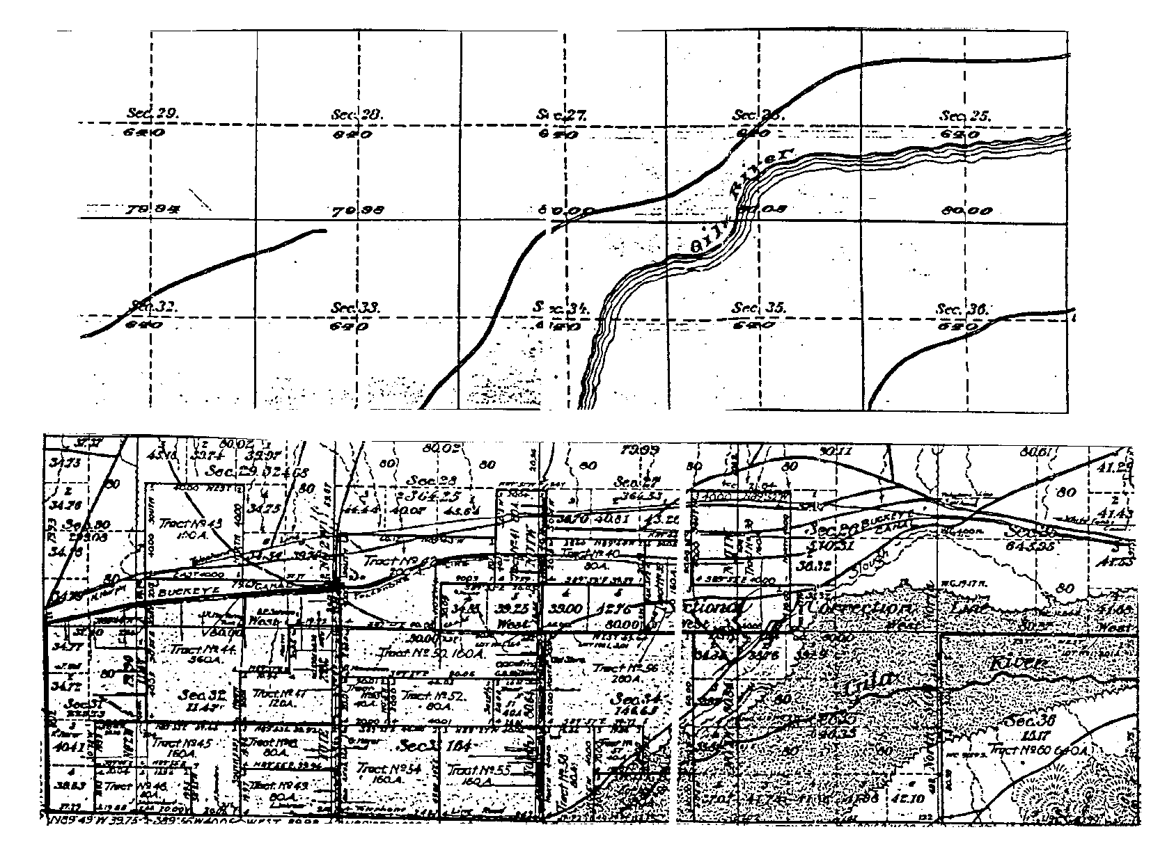
Flood-induced Changes in Channel Width
GLO Plats T1N, R2W
1883
1907

Slide 23
Location of GLO Plat (March 7, 2014)

Slide 24
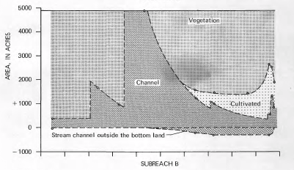
Historical Changes in Gila River (San Simon to Pima)
Source: Burkham (1972)
1870
1900
1940
1970

Slide 25
Channel Width Change, Middle Gila River

Slide 26
Summary of Opinions
Mid-1800s:
  Portions of Gila River had single-thread channel lined with thick stands of woody riparian vegetation.
  It may have been possible to float a small boat in some reaches under some flow conditions
1895 to1916:
  Large floods scoured vegetation, eroded the banks, widened the channel,
  Gila River developed wide braided planform.

Slide 27
Summary of Opinions
Early-1900s, including date of statehood:
  Extensive reaches were dry; carried little or no flow except during flooding.
  Braided planform and low to non-existent flows would have made commercial navigation impractical.
  During flood periods, navigation also impractical due to hazardous conditions, debris, uncertain and unstable channels.
Prior to mid-1800s:
  Reconstructed flow records show mid-1800s unusually dry
  Large floods routinely occurred in the ordinary and natural condition of the Gila River

Slide 28
Summary of Opinions
The Gila River was NOT used nor susceptible to being used, in it ordinary and natural condition, as a highway for commerce, using customary modes of trade and travel on water at the time of Arizona’s statehood.

