Slide 1
Notes:
Registered Professional Engineer
Registered Land Surveyor
Certified Professional Hydrologist
State Water Right Surveyor (Nevada)

Slide 2
Legal Standards
Navigable in Fact or
Susceptible of Navigability
Ordinary and Natural as of the date of Statehood

Slide 3
Navigable in Fact
Only 1 instance of using a boat is recorded
Pattie Beaver Trapping Party made a canoe
Probably on the San Pedro River
It was made because “one of our number had already been drowned, man and horse, in attempting to swim the river”
This means that the river was at or near flood stage
Notes:
Source: Pattie, pg 136

Slide 4
Navigation was Needed
Mines began in 1877
Needed equipment
Needed way to get the product out
“Large shipments of mining and smelting equipment transported in twenty-mule team freight wagons to the early developed mining regions of southern Arizona, crossed over this bridge"
Notes:
Source: Fuller pg 3-19

Slide 5
Navigation was Needed (cont.)
The Railroad arrived
“The nearest settlement of any size was Tucson, from which all supplies for this region were freighted. The growth of the settlement was consequently slow until in 1880, in which year the Southern Pacific Railroad was built, giving more ready access to the region.”
Notes:
Source: Carpenter and Bransford pg 249
See Appendix A - The Need for Transportation

Slide 6
Susceptible of Navigability
Ordinary and Natural as of the date of Statehood
Ordinary relates to flow
Not a flood
Not an exceptional drought
Natural relates to the channel and watershed
What would the channel and watershed have looked like in 1912, IF you were the first human to enter the area.

Slide 7
“Ordinary”
“ ‘ordinary’ means ‘[o]ccurring in the regular course of events; normal; usual.’ ”
The Court goes on to add that it does not include major droughts or floods
.
Notes:
Source: Hyatt pg 24

Slide 8
Freethey and Anderson Map
“…the maps have limitations that require ADWR to undertake additional verification. Limitations include the quality of the sources of information and inconsistencies, inaccuracies, and omissions in the maps.” (Special Master Schade)
Notes:
Source: Freethey and Anderson
Source: ADWR Appendix A-3 pg 26-27

Slide 9
N
Notes:
Source: Turner

Slide 10
Pre 1890 Conditions
Notes:
Source: Hendrickson and Minckley Figure 9b
Dashed Lines are ephemeral flow.
These reaches are highlighted in red.
Note the map has no category for intermittent flow.
Wide areas on river are cienega/marsh

Slide 11
Historic Accounts Support Non-Perennial Reaches
“The flow of water, however, is not continuous. One or two localities were observed where it had entirely disappeared, but to rise again a few miles distant, clear and limpid.” Hjalmarson
Numerous observations in the 1840’s and 1850’s reported dry reaches
Notes:
Source: Hjalmarson 1988 (attachment to article)
See Appendix A - Intermittent Flows

Slide 12
Important Terms
Mean Average or Average
Median Average
Base Flow
River Gage

Slide 13
Base Flow
Why does a river flow when the snow is not melting and it has not recently rained?
Numerous definitions
The Tombstone Report spent a full page listing many of the definitions
Q₉₀ is not one of them
Notes:
Source: Kennedy and Gungle

Slide 14
Freethey and Anderson Warn
“The data …represent a conceptual model…”
“The individual … values represent an approximation of each component derived by balancing the entire regional water budget. The diagrams represent a means of comparing the magnitude of the total budget and the individual components…”
Notes:
Source: Freethey and Anderson Plate 1

Slide 15
Notes:
Source: Hjalmarson 2013 Slide 68

Slide 16
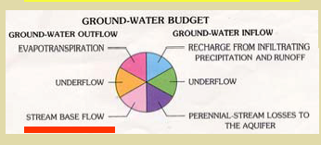
Notes:
Source: Freethey and Anderson Plate 3

Slide 17
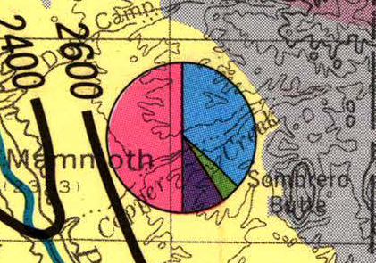
Notes:
Source: Freethey and Anderson Plate 3

Slide 18
Baseflow Answers According to Freethey and Anderson
Gage Baseflow (cfs)
Gookin Hjalmarson
Palominas 0 4*
Charleston 9 10*
Narrows (join) 7.3 7.5
Mouth ??? 4
* From a different source
Notes:
Source: Hjalmarson 2013, data from Slide 71

Slide 19
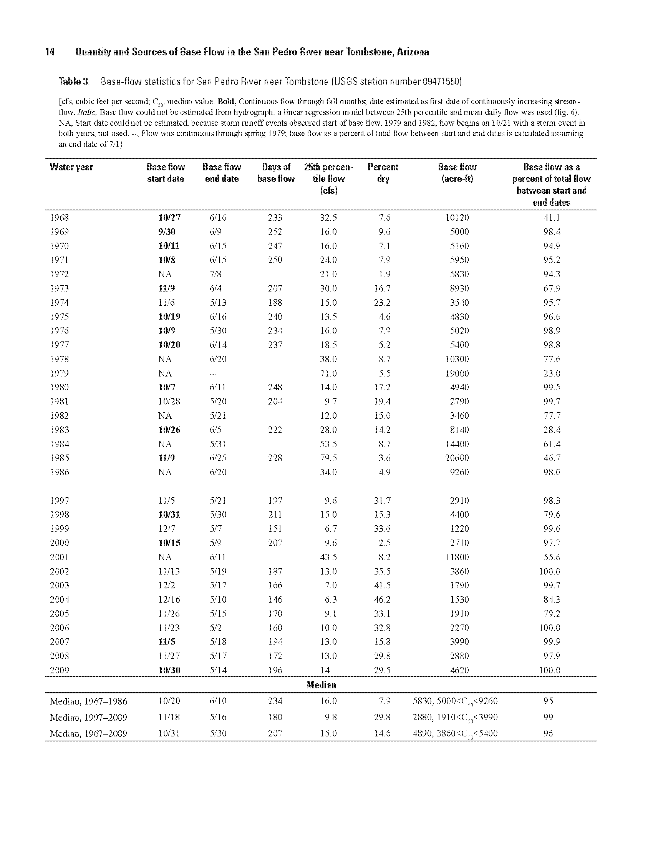
Notes:
Source: Kennedy and Gungle pg 14

Slide 20
Median = Baseflow
It seems counter intuitive until you look at the flows
Virtually no snow melt
Most significant flows are in direct response to precipitation

Slide 21
Typical Year
Notes:
Source: USGS data

Slide 22
Notes:
Source: USGS data

Slide 23
Notes:
Source: USGS data

Slide 24
Baseflows at gages are the best case scenario
N
Notes:
Source: Dickinson et. al. pg 17

Slide 25
Mean Average Flow
Krug Report “Average Annual Runoff”
1951-1980
Groundwater Pumping is large
Considerable Development
Computed flows at 5,951 stations
Extrapolated data for over 3,000 stations
5 years
Almost six gaging stations per work day
Notes:
Source: Krug et. al.

Slide 26
Bureau of Reclamation- White Book
1914-1945 Close to Arizona Statehood
Groundwater pumping is small
Vegetative changes are not as extensive
Fewer human uses
More information was available on early uses at the time the report was written
Over 1 million hours involved in producing it
Notes:
Source: U.S. Bureau of Reclamation

Slide 27
Bureau of Reclamation- White Book
BOR accounts for replacement of native vegetation
BOR accounts for human induced riparian vegetation change
BOR accounts for M&I use
BOR accounts for irrigated acreage year by year

Slide 28
BOR “White Book” Depletions
Notes:
The Winkleman watershed was calculated separately for
depletions. Those depletions were added to those of other
watersheds for use at Kelvin due to there not being
a gage at Winkleman during the period.

Slide 30
Need to determine 3 things
Soils and Vegetation in the Channel--→n
Slope-→S₀
Shape of the Channel →(0.67d)^{5/3}W
0.67 is the shape factor for Parabolic
Changes to1.0 if the channel is Rectangular
Notes:
Source of equation: Burkham

Slide 31
Pre-Entrenchment Alluvium
Notes:
Source: ADWR Fig 4-1

Slide 32
Pre-Entrenchment Alluvium
Is not medium silt clay
The pre-entrenchment channel was in 1924:
Fine Sandy Loam
Silt Loam
Fine Sand
Silty
“…interfingering coarse sandy to pebbly braided channel and fine sand to silty river floodplain deposits…” AzGS
Saturated Floodplain Holocene or Subflow due to high well yields because it lacks clay
Notes:
Source: Carpenter and Bransford pg 254, 271-2
Source: ADWR App C pg 43
See Appendix A - Pre-Entrenchment Soils

Slide 33
Post Entrenchment Alluvium
Notes:
Source: ADWR Figure 4-1

Slide 34
Post-Entrenchment Alluvium
Is coarser than the Pre-Entrenchment Alluvium
Sands
Gravel
Cobbles
Boulder
Notes:
See Appendix A – Post-Entrenchment Soils

Slide 35
Charleston October 8 1964 10 CFS
Notes:
Source: Beaulieu et. al. pg 57

Slide 36
0.062mm
Median is
Sand
Notes:
Source: Beaulieu et. al. pg 57
Soils .062mm or less are required for silty clay
Source: Osterkamp 1980 pg 190

Slide 37
Notes:
Source: Beaulieu et. al. pg 41

Slide 38
Historic Observations
1849 “a clear stream, running over a rocky bed”
1854 “flows …over a light, sandy bed”
1854 “intermittent sandy-bottomed”
1867 “the Pedro is small shallow stream sandy”
1891 “an ‘insignificant sand-bed’ ”
<1895 “continuous sand-bed was formed”
1901 “The U.S. Geological Survey's Twenty-First Annual Report was the first published account to note the presence of a sandy channel bed”
Notes:
1849 Source: Fuller pg 3-15
1854 (1st) Source: Fuller pg 3-17
1854 (2nd) Source: NRCS pg 14
1867 Source: Dobyns 1995 pg 32
Source: Fuller pg 3-19
<1895 Source: Wood pg 23
1901 Source: Wood pg 22

Slide 39
Slope
Slope varies a lot along a river
Slopes at gaging stations
Palominas .0014
Charleston .0024
Redington .0038
Slopes along reaches
Narrows to Redington .003
Reddington to Winkleman .004
Notes:
Source: Osterkamp et. al., 1982 Table 1 for gaging stations
Source: Fuller pg 5-8 for reaches

Slide 40
Meanders Affect Slope
Meanders are measured as sinuosity
Sinuosity is the distance following the river divided by the distance “as the crow flies”
Hjalmarson assumed 1.5
Historic Testimony said 2.0
Meander sinuosities also vary
Meander sinuosity of 1.5 is the boundary between straight and braided (Leopold pg 60)
Notes:
Source: Dobyns 1995 pg 22-23 for Historic Testimony

Slide 41
Notes:
Source: Hjalmarson 2013 slide 106

Slide 42
Notes:
Source: Leenhouts, et.al. pg 18

Slide 43
Riffles
Very common
They have radically different slopes than the intervening pools
They have radically different soil structures than the intervening pools
Notes:
See Appendix A - Riffles

Slide 44
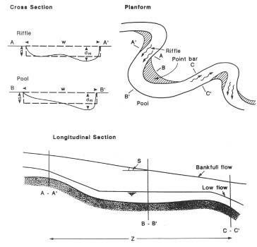
Notes:
Source: N. Carolina Stream Restoration Institute pg 11

Slide 45
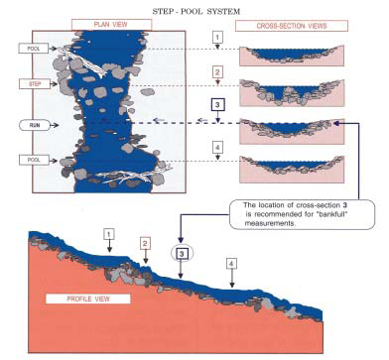
Notes:
Source: N. Carolina Stream Restoration Institute pg 11

Slide 46
Near Charleston
Notes:
Source: Beaulieu et.al. pg 34

Slide 47
Near Charleston
Notes:
Source: Rose Cover Photo, no date of photo provided

Slide 48
Channel Shape
There is no such thing as a single channel shape that is the “natural shape” for all streams
Many things can cause streams to change form
Climatic variation
Animal activity
Vegetation changes
Human activity
Tectonic activity
“Everything changes and nothing remains still .... and ... you cannot step twice into the same stream" (Heraclitus)
Notes:
See Appendix A - River Variability

Slide 49
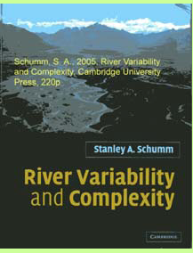
Schumm
“1. there is a spectrum of river types that is dependent upon hydrology, sediment loads, and geologic history (in other words, rivers differ among themselves);
2. rivers change naturally through time as a result of climate and hydrologic change;
3. there can be considerable variability of channel morphology along any one river, as a result of geologic and geomorphic controls: (Schumm and Winkley, 1994),”
Notes:
Source: Schumm pg 4

Slide 50
Channel Shape
On the San Pedro there was an historic repeat of prehistoric events that are called entrenchments
Many reasons have been suggested for the historic entrenchment
Cattle Grazing
Climatic Variations
Others
Not a unique nor a human-caused event

Slide 51
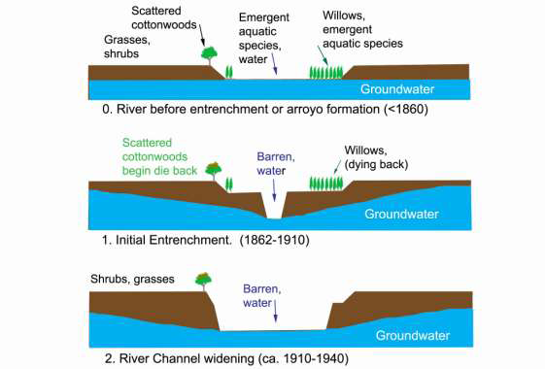
Notes:
Source: Noonan pg 53

Slide 52
Notes:
Source: Noonan pg 53

Slide 53
Entrenchments
Prehistoric entrenchments
Overgrazing and no entrenchment (1700-1845)
Entrenchment during undisturbed time (1846-1870)
Entrenchment during development (1870’s-1880’s)
1890 to Statehood

Slide 54
Entrenchments are Natural
Notes:
Source: Waters pg 338
See Appendix A - Prehistoric Entrenchments

Slide 55
1700 to 1845
Prior to 1700, Pimas were farming the Lower San Pedro and had 100,000 Cattle
No record of entrenchment or destruction of the watershed
Notes:
Source: ANSAC pg 21 & Fuller pg 3-7 for Item 1

Slide 56
There Were Non-Flow Obstacles to Navigation
Without trapping, beaver dams would have been prevalent
Cienegas existed
Riffles existed

Slide 57
Notes:
Source: Lomeli

Slide 58
Notes:
Source: Hjalmarson 2013 Slide 160
See Appendix A - Beavers
140 miles *1.6 Km per mile*.5 colonies per km = 112 dams
140 miles *1.6 Km per mile* 7.5 colonies per km=1680 dams
This river was named “Beaver Creek” by Pattie

Slide 59
Arivaca Cienega 3/10/10
Notes:
See Appendix A - Cienegas

Slide 60
Canelo Hills Cienega

Slide 61
Bingham Cienega
Notes:
Source: Pima Association of Governments

Slide 62
St. David Cienega
Notes:
St. David Cienega

Slide 63
Pre-1890 Conditions
Notes:
Source: Hendrickson and Minckley Figure 9b
Dashed Lines are ephemeral flow.
These reaches are highlighted in red.
Note the map has no category for intermittent flow.
Wide areas on river are cienega/marsh

Slide 64
1846-1870
Human influences were about a low as they can get.
Grasslands were in excellent condition
The cattle were disappearing
But entrenchment began
Notes:
See Appendix A - The Abundance of Grass 1846-1870 for item 2
See Appendix A - The Cattle Were Disappearing for item 3
See Appendix A – The First Historic Entrenchment for item 4

Slide 65
The River was Braided
“These same streams prior to 1880 coursed unincised across alluvial fills in shallow, braided channels, often through lush marshes.”
Not all was braided
Notes:
Source: Hendrickson and Minckley 1984 pg 131

Slide 66
The grass was still good
1880’s “On any given day in the 1880's, a horseback ride along the San Pedro River would offer a visual experience that today is hard to imagine. In the spring and summer along the San Pedro one would still see acres of golden brown grasses turned to green…”
1882 “In June of that year,… We passed several fine ranches, and saw numbers of fat cattle and horses. This region is unexcelled for its splendid grazing and agricultural lands."
Notes:
Source: Rose pg 3 for 1880’s
Source: Dobyns 1995 pg 49 for 1882

Slide 67
Humans did not cause the entrenchment
There were floods
1881, 1886, 1887
There was more entrenchment
Notes:
See Appendix A – The 1880’s Entrenchment

Slide 68
The Great Flood of 1890
The 1890 flood occurred due to several monsoon rains in late July and early August
This caused extensive entrenchment
But not the entire river
Notes:
Source: Dobyns 1995 pg 67-72 for item 1
See Appendix A – The 1890 Entrenchment for item 2
See Appendix A – Reaches Not Entrenched in 1890 for item 3

Slide 69
Extensive Entrenchment
“in August, 1890, it [the San Pedro] began carving a steep-walled trench…(Hastings 1959)”.
“the first mention of extensive channel widening and channel entrenchment were described in newspaper accounts of the damage resulting from the flood events of August and September 1890”
Notes:
Source: Fuller pg 3-20, 21
Source: Wood pg 24

Slide 70
But not Everywhere
The main channel of the San Pedro River did not become incised into the floodplain in the Redington area, however, until the flood of September 1926 (J. Smallhouse, oral communication, 1996).
Notes:
Source: Fuller pg 5-14

Slide 71
Destruction of the watershed 1891
“The 1890-91 winter precipitation carpeted the range with grass, so graziers were optimistic. The 1891 summer monsoon did not begin until 21 July, and thunder showers fell in their usual erratic pattern. By September, residents perceived that a drought gripped the Southwestern United States. The San Pedro River Valley range was ‘absolutely bare.’”
Notes:
Source: Dobyns 1995 pg 74

Slide 72
Floods caused the entrenchment
“The cause of entrenchment is the subject of considerable debate among hydrologists, but a strong argument can be made for change of climate.” Hjalmarson
Others who agree:
Huckleberry
Hereford
Betancourt
Wood
Fuller
Notes:
Source: Hjalmarson 1988 pg 1
See Appendix A - Floods and Entrenchment

Slide 73
The river would not recover by 1912
Floods continued in 1891, 1893, 1894, 1896, 1900, 1901, 1904, 1905
USGS indicates that the flood of 1906 was probably greater than the flood of 1926.
The flood of 1926 had 100,000 cfs. Over double the 100-year flood
Recovery takes decades in the semi-arid Southwest
Notes:
Source: Wood pg 5 for item 1
Source: Pope et. al. pg 389 for items 2 & 3
See Appendix A - Stream Recovery for item 4

Slide 74
Palominas, 1930 and 1981

Slide 75
Condition as of 1912
San Pedro River was mostly a braided stream
San Pedro River was mostly entrenched with vertical sides
Cienegas on the river were gone
Beaver dams were gone or mostly gone
Some of the San Pedro was in its pre-entrenchment state
Notes:
See Appendix A - Statehood Condition

Slide 76
Charleston
1/4/25 6cfs

Slide 77
At Highway 92 on the Way to Bisbee AKA Palominas
May 24, 1939
1 CFS

Slide 78
Charleston Bridge
12/14/42 16 cfs

Slide 79
Charleston
April 17, 1930
13 cfs

Slide 80
Palominas 4/17/30 No Flow Data

Slide 81
Near Fairbanks April 17 1930
Charleston Flow 13 cfs

Slide 82
What if I am wrong?
The Floods did occur
If the Floods had not caused the entrenchment, they would have greatly widened the channel creating some braiding
The beavers and cienegas would still be there
Some riffles would still exist

Slide 83
Two Ways to Get Depth
What Did People See?
1846 12 inches deep
1849 15 inches deep
1854 18 inches deep
1857 12 inches deep
1857 15 inches deep
1858 12 inches deep
Channel Geometry Method
Notes:
Source: Fuller pg 5-13 for 1846
Source: Fuller pg 3-17 for 1849
Source: Fuller pg 3-17 for 1854
Source: Fuller pg 3-18 for 1857 (1st)
Source: Hereford and Betancourt pg 136 for 1857 (2nd)
Source: Fuller pg 3-18 for 1858

Slide 84
Notes:
Source: Hjalmarson Slide 117

Slide 85
The Channel Geometry Method has Limitations
It is used to determine flows by measuring at:
“A straight, narrow reach in which flows are approximately uniform”
For the Mean Annual Flow you should use:
“The section defined by the lowest channel bars is most commonly related to mean flows”
By reversing the use of the equation, the equation now predicts the channel widths only at certain spots in the river
Notes:
Source: Barnes, Jr. No Pg

Slide 87
The Equation Used is Not for Braided Channels
Osterkamp, in 1980, presented the equation used by Hjalmarson
He and others warned it was invalid for braided channels
In 1983 he determined a series of differing equations based on a width to depth ratio
For a high W/D ratio (i.e. a braided stream) he determined:
W= 1.24 Q ^{0.82}
The exponent is much different 0.82 vs. 0.57
Notes:
Source: Osterkamp et.al. 1983 pg 7 for formula (converted to U. S. Units)
See Appendix A - Channel Geometry Method – Braiding and Flooding

Slide 88
The 1980 Channel Geometry Method Has Several Assumptions
Soils
Assumes a large amount of clay
San Pedro does not have much clay
Uniform parabolic cross section
Historical accounts say the San Pedro cross-section was rectangular
This changes the 0.67 factor in the Manning’s Equation to 1

Slide 89
Further Assumptions
Slopes were assumed to be relatively uniform
0.21% or 0.28%
Slopes really vary from
0.14% to 2.40%

Slide 90
Ignores Natural Obstacles
Riffles
Beaver Dams
Cienegas

Slide 92
Channel Geometry Method has Significant Error State of Washington Experience
[A]lthough the predicted hydraulic depth at a mean annual discharge of 1,660 cubic feet per second is 3.5 feet, 90-percent prediction intervals indicate that the actual hydraulic depth may range from 1.8 to 7.0 feet.
Notes:
Source: Magirl and Olsen pg 1
See Appendix A - Channel Geometry Method – Error

Slide 93
Navigability Criteria
Modern Recreation
Bureau of Outdoor Recreation
Cooperative Instream Flow Service Group
Commercial Navigation
Commercial Canoes in 1914
Washington State
Langbein
Army Corps of Engineers

Slide 94
Bureau of Outdoor Recreation
For “Tranquil” Water
A Canoe requires two feet if you want to paddle
Width needs to be 25 feet
For white-water rapids you use the chart
Notes:
Source: Hjalmarson 2013 slides 139-140
Source: Cortell pg 14 for two foot requirement
Based on Hjalmarson model depth requires 191cfs
Source: Cortell pg 21 for Width
Based on Hjalmarson model width requires 41 cfs

Slide 95
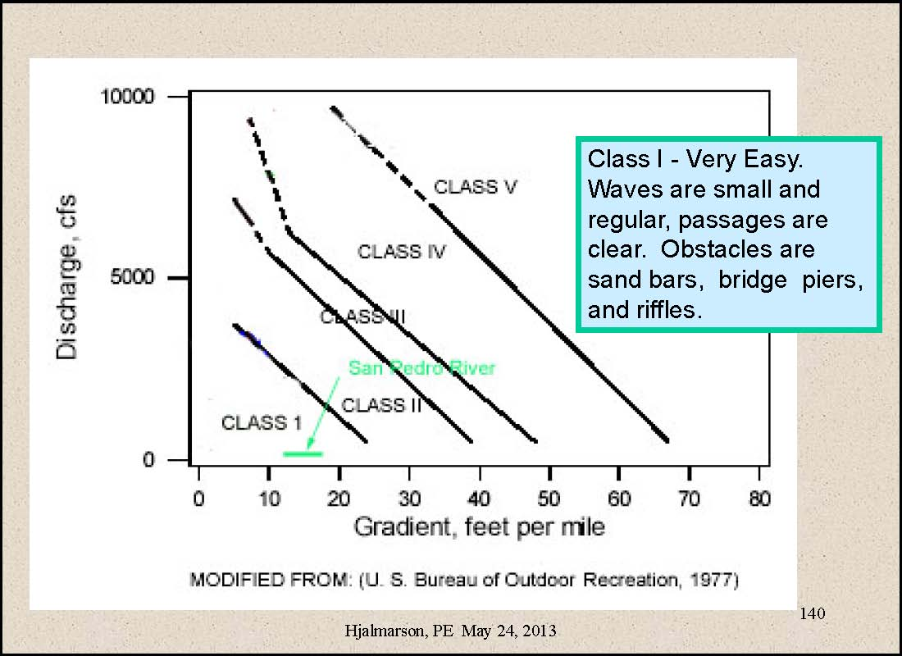
Bureau of Outdoor Recreation
Notes:
Source: Hjalmarson slide 140

Slide 96
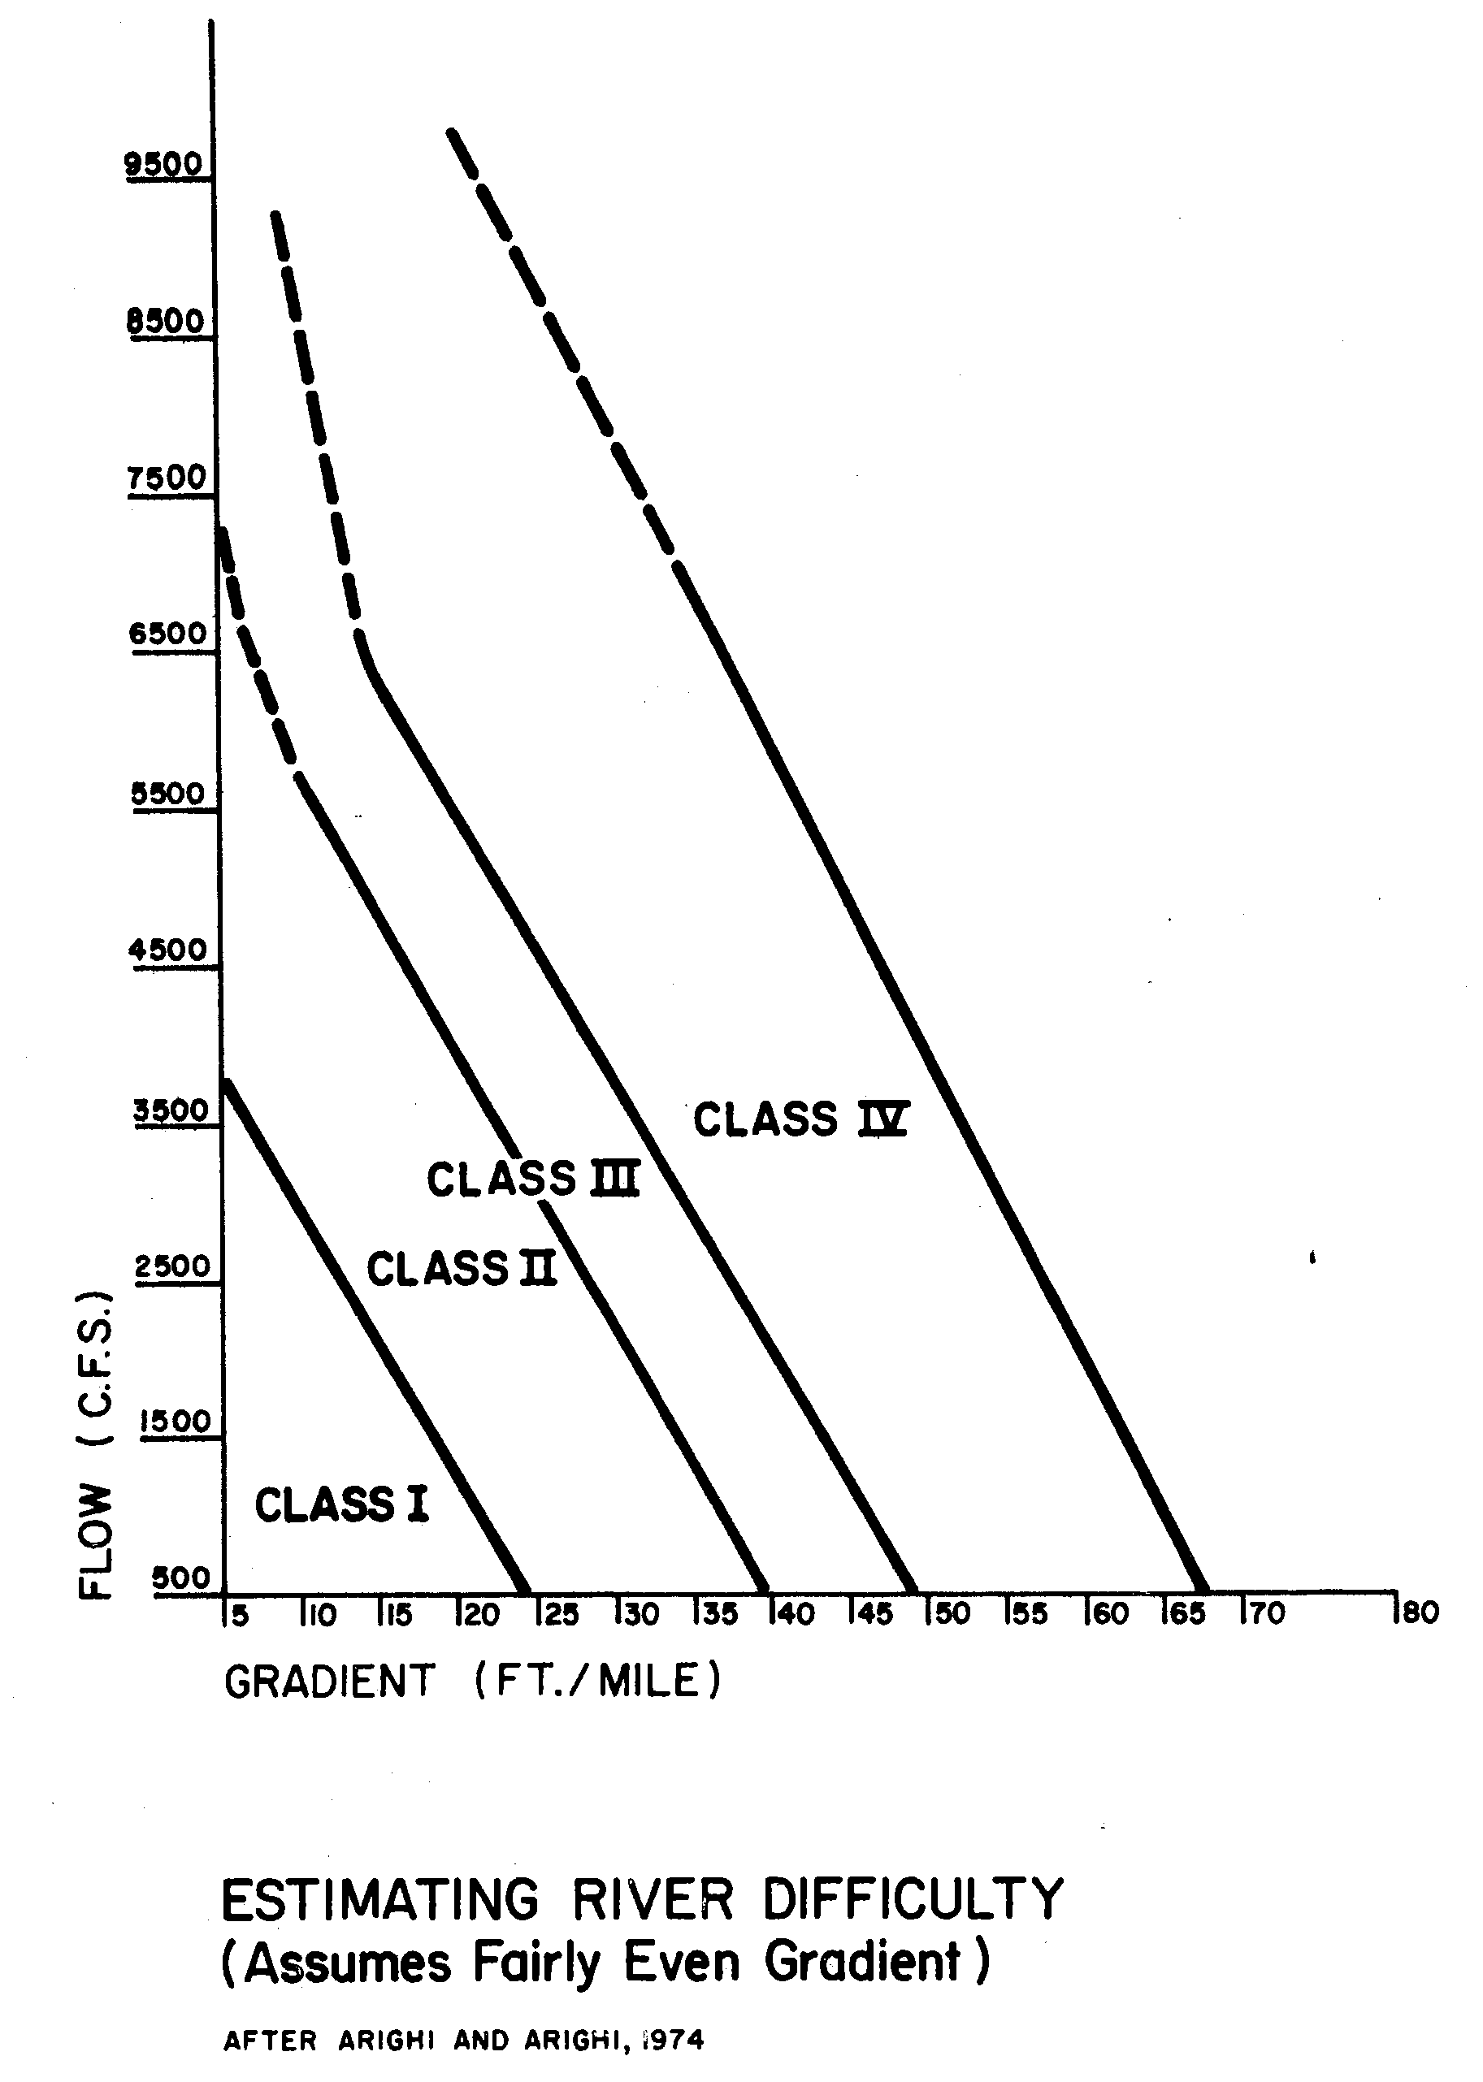
Notes:
Source: Cortell pg 18

Slide 97
Near Charleston
Notes:
Source: Beaulieu and others pg 34
Slope between Transect A2 and A3 is 125 feet per mile

Slide 98
Bureau of Outdoor Recreation
Notes:
Source: Hjalmarson slide 140
Slope between Transect A2 and A3 is 125 feet per mile

Slide 99
Class V
Very Difficult. Rapids are long and very violent, following each other almost without interruption. The riverbed is extremely obstructed with large drops and violent currents.
Notes:
Source: Cortell pg 16

Slide 100
Cooperative Instream Flow Service Group
The method is for recreational boating not commercial
“The approach is based on the assumption that a single cross section, properly located, can define a minimum flow requirement. Such a cross section is located at an area displaying the least depth across the entire stream.”
Notes:
Source: Cooperative Instream Flow Service Group

Slide 101
Commercial Canoe
Carrying weight makes the canoe ride lower
Pinkerton in 1914 said 19 inches for a freight canoe
Army Corps says draft should only be 75% of river depth
Requires depth of 25 plus inches
Notes:
Source: Pinkerton near the end of Chapter 2
Source: U.S. Army Corps of Engineers 1980 pg 4-2

Slide 102
State of Washington
Notes:
Source: Magirl and Olsen pg 2

Slide 103
Langbein Method
Notes:
Source: Langbein Figure 13

Slide 104
Army Corps of Engineers as Directed by Congress
1866 4 feet deep Upper Mississippi
1878 4.5 feet deep Upper Mississippi
1896 9 feet deep Lower Mississippi
1907 6 feet deep Upper Mississippi
1907 6 feet deep Lower Missouri
1910 9 feet deep Ohio
Notes:
See Appendix A - Criteria of Navigability

Slide 105
Summary of Key Flows
Depth Hjalmarson Gookin
1 feet 19 cfs 96-905 cfs
2 feet 191 cfs 1000+ cfs
3 feet 915 cfs 1000+ cfs
4 feet 1000+ cfs 1000+ cfs
6 feet 1000+ cfs 1000+ cfs
Width
25 feet 41 cfs 39-41 cfs
Notes:
For Sand one foot depth requires: 134 cfs
For Riffle one foot depth requires: 96 cfs
For Braided one foot depth requires: 905 cfs

Slide 106
Charleston 6.5 CFS

